Slide 1





Effective Board Leadership:
President and Vice President Essentials
MCCSA Webinar Series
2026/2027
Presented by:
Angela L. Irwin, Owner
AirWin Educational Services, LLC
Notes:
Welcome and introductions – housekeeping items . . .
Tonight, we are going to focus specifically on the leadership roles of the board president and vice president.
We often spend a lot of time talking about what boards are responsible for, collectively, and appropriately so. But how that board functions is influenced significantly by its officers.
Tonight, I want us to look beyond the procedural responsibilities of these positions and think about something bigger: How do effective officers help an entire board govern more effectively?
We’re going to talk about meetings, consensus, accountability, relationships, and the partnership between the president and vice president – and, most importantly, some very practical things you can begin doing immediately.

Slide 2
KEY MESSAGE
The President is not “the boss of the board,” and the vice president is not simply a substitute waiting in the wings. Both are stewards of the board’s effectiveness!
Notes:
I want to begin with one important idea . . . The president is not the boss of the board.
The president certainly has additional leadership responsibilities, but every board member has one vote, and the authority of the board rests with the board, collectively.
And, similarly, the vice president isn’t simply someone who waits in the wings in case the president misses a meeting.
Both officers have a much more meaningful role. They are stewards of the board’s effectiveness! Their job is not to exercise more authority than everyone else. Their job is to help create the conditions in which the entire board can exercise its authority effectively.
That distinction is really the foundation for everything we’re going to talk about today!

Slide 3
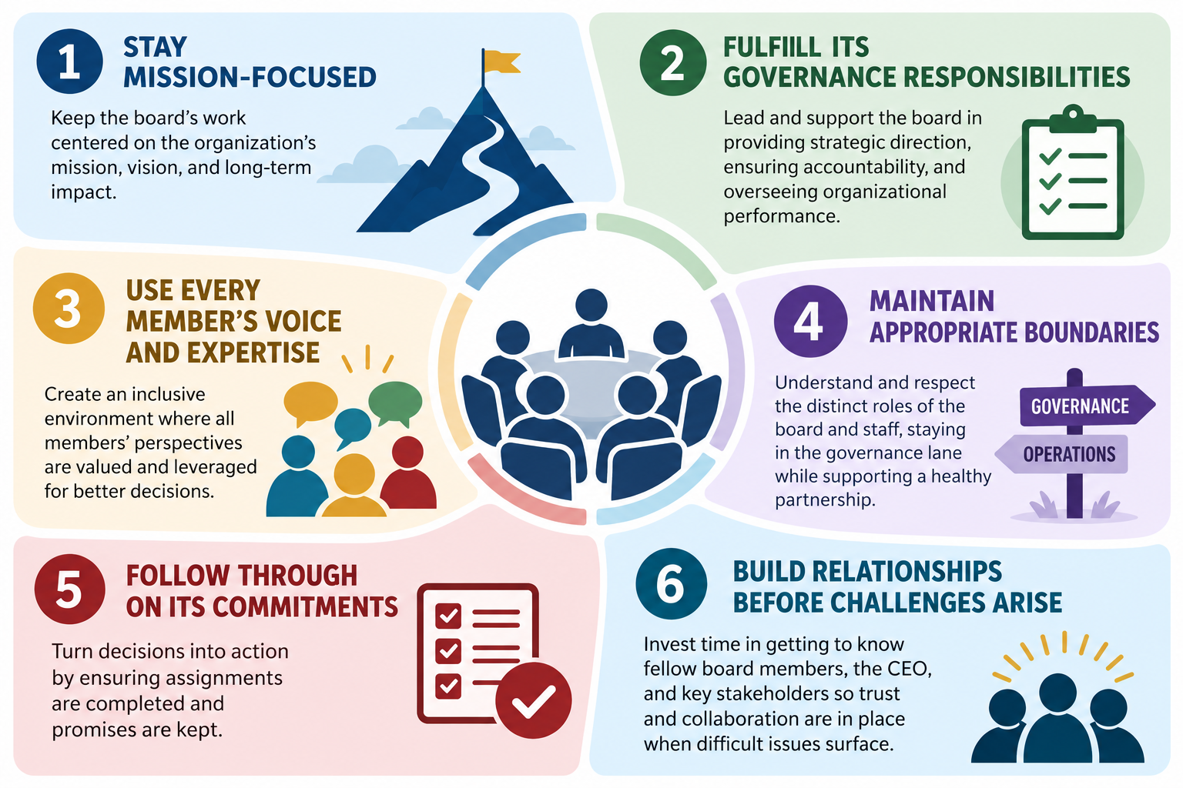
SIX THINGS EFFECTIVE OFFICERS
DO FOR THE BOARD
Notes:
When we think about effective officer leadership, I think there are six things that really matter.
First, officers help the board stay mission-focused. When conversations begin drifting, one of the most important leadership questions is simply: How does this connect to our mission or priorities?
Second, they help the board fulfill its governance responsibilities – not management responsibilities, but governance responsibilities.
Third, they create space for every member’s voice and expertise. Effective leadership isn’t about doing most of the talking. In fact, very often it is about making sure other people are talking.
Fourth, officers help maintain appropriate boundaries. They recognize when a conversation has crossed from governance Into operations and help redirect it.
Fifth, they help the board follow through on its commitments. A decision at a board meeting isn’t particularly meaningful no one remembers what happens next.
And, finally, effective officers build relationships before challenges arise.
The last one is especially important. The middle of a crisis is a difficult time to begin building trust. Strong boards make those investments long before they need to draw upon them.
OPTIONAL: As you look at these six, which one do you think is easiest for your board – and which one requires the most intentional effort?

Slide 4
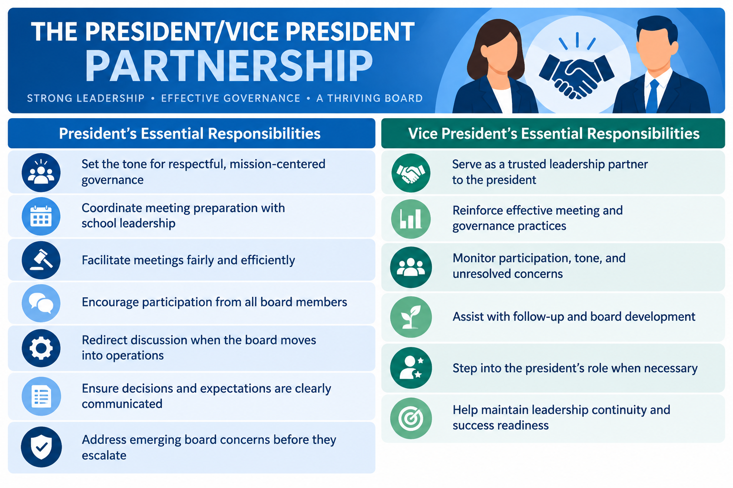
THE PRESIDENT/VICE PRESIDENT PARTNERSHIP
Notes:
This brings us specifically to the partnership between the president and vice president. You’ll notice there are differences between these two columns – but they are highly complementary.
The president has a very visible leadership role: setting the tone, preparing for facilitating meetings, encouraging participation, maintaining governance boundaries, clarifying decisions, and addressing concerns before they escalate.
But look at the vice president’s side.
This isn’t a passive role
The vice president can be listening and watching n ways that the president sometimes cannot while facilitating a meeting: Who’s participating? Who isn’t? What’s the tone in the room? Is there an unresolved concern? Is the conversation beginning to move in an unhealthy direction?
The vice president also becomes an important thought partner for the president.
So I would encourage presidents and vice presidents to think of themselves not as primary and backup, but as a leader team serving the board.

Slide 5
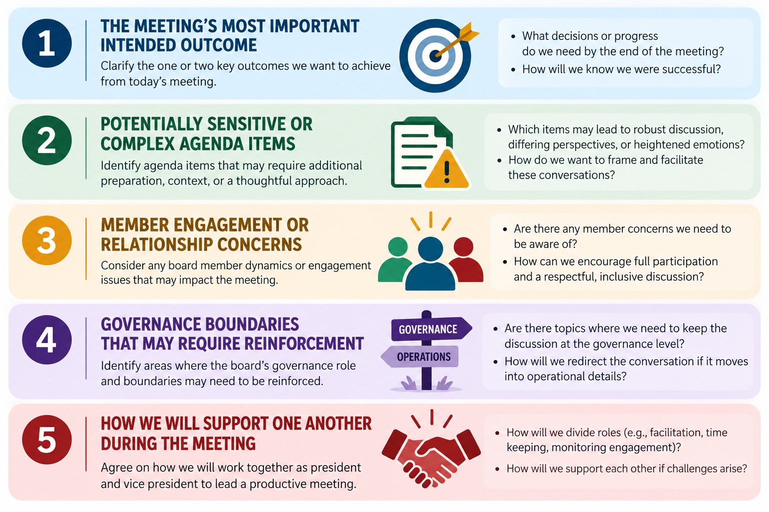
LEADERSHIP PRACTICES
Notes:
So what does that partnership look like in practice?
One of the simplest strategies I recommend is a brief president/vice president check-in before each board meeting.
This doesn’t need to be an hour-long meeting. Ten or fifteen focused minutes can make an enormous difference.
Talk about five things:
First, what is the most important outcome we need from this meeting?
Second, are there sensitive or complex agenda items that require thoughtful facilitation?
Third, are there member engagement or relationship concerns we need to be made aware of?
Fourth, are there governance boundaries we may need to reinforce?
And finally, how are we going to support one another during this meeting?
Maybe the vice president watches the clock. Maybe the vice president pays particular attention to participation. Maybe you already know there is an agenda item where the president is going to need help keeping the conversation at the governance level.
That short conversation moves officers from simply attending the meeting to intentionally leading the meeting together.

Slide 6
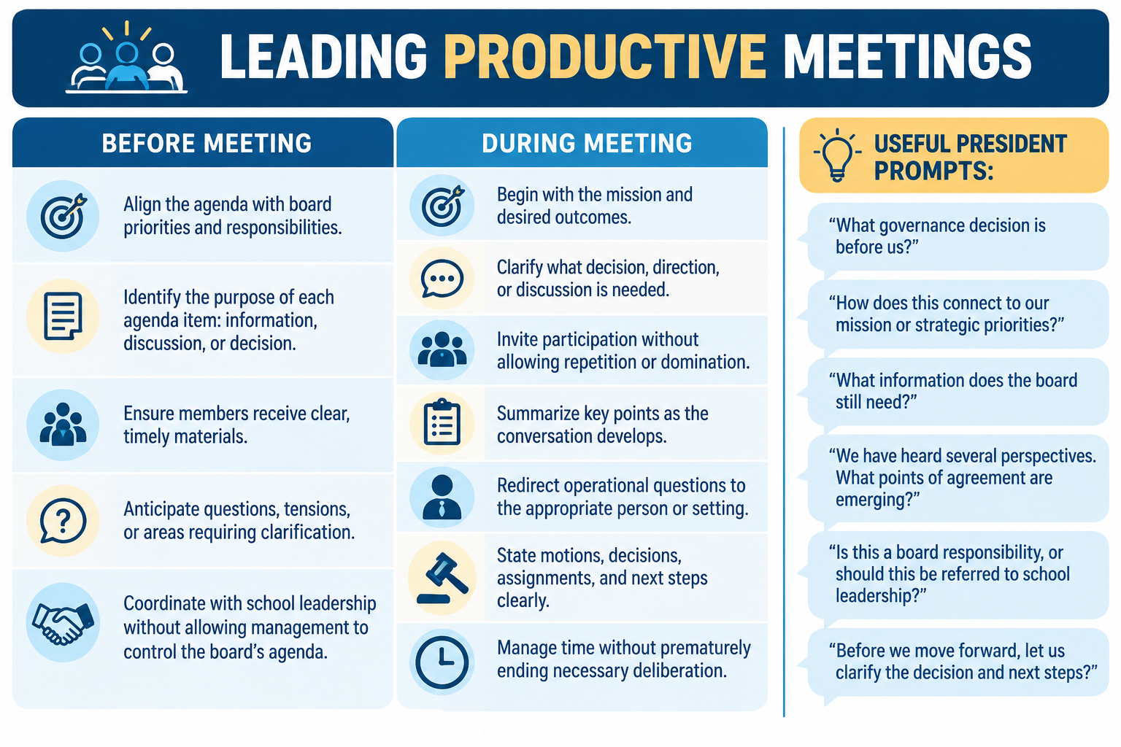
LEADING PRODUCTIVE MEETINGS
Notes:
Now let’s talk about the meeting itself . . .
Productive meetings actually begin before the meeting.
The agenda should align with board priorities. Members should know why each item is there. Materials should arrive early enough to be reviewed. And the president should anticipate where questions or tension might arise.
Notice something else on the slide: coordinating with school leadership does not mean allowing school leadership to control the board’s agenda. It should be a partnership.
Then, during the meeting, the president becomes the facilitator of the board’s governance process.
One of the most powerful tools available to a president is the question.
Instead of saying, “We’re getting too operational, try – Is this a board responsibility, or should this be referred to school leadership?
Instead of allowing a discussion to wander, ask: What governance decision is before us?
And when the conversation seems stuck:
We’ve heard several perspectives. What points of agreement are emerging?
Good facilitation doesn’t shut down discussion. It gives discussion direction and purpose.

Slide 7
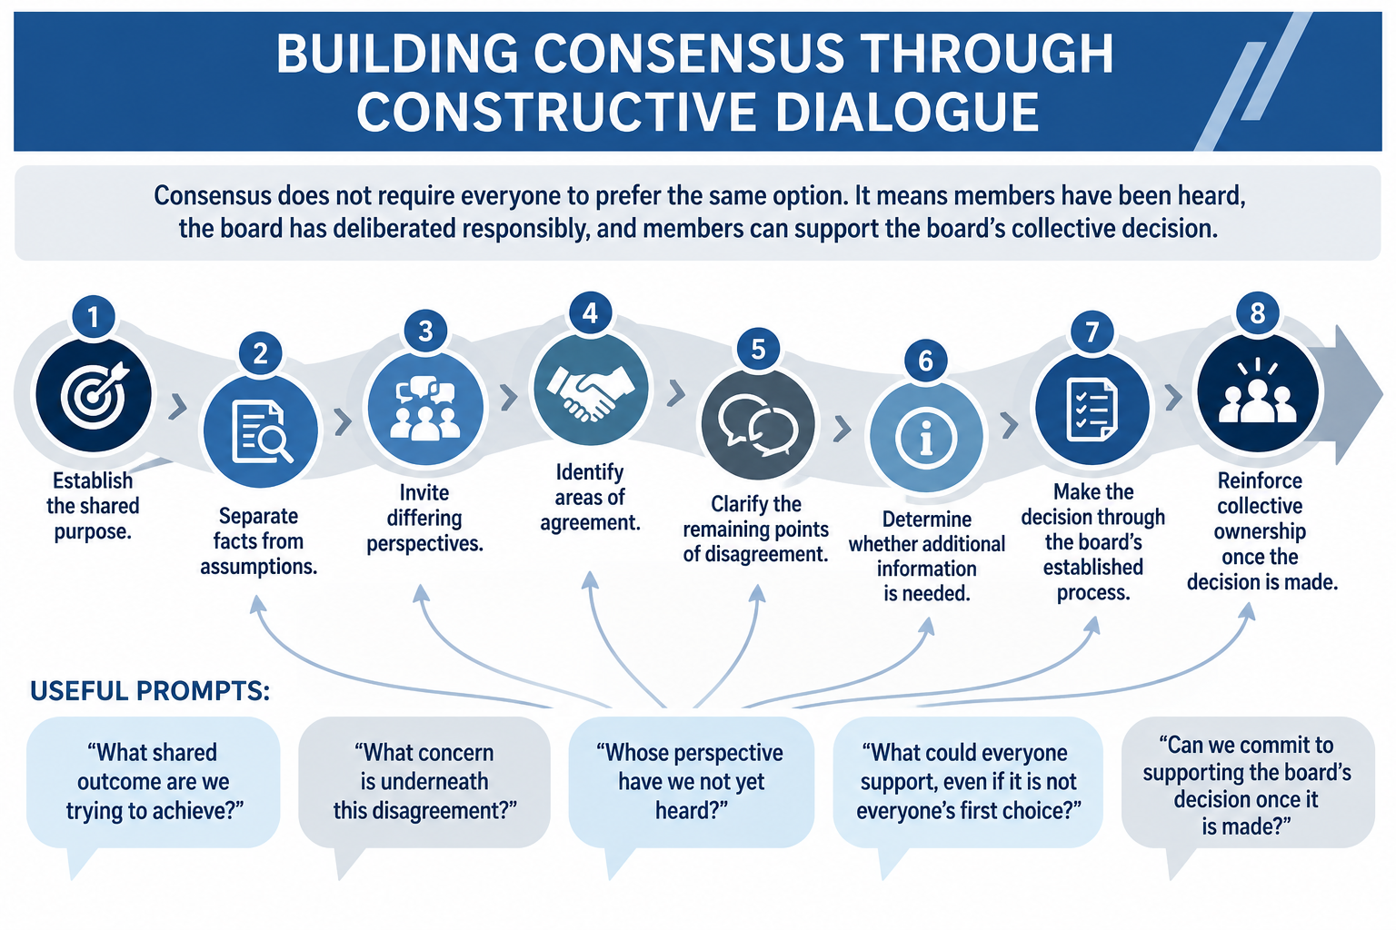
BUILDING CONSENSUS THROUGH CONSTRUCTIVE DIALOGUE
Notes:
This is particularly important when boards disagree.
I want to make a distinction here: consensus does not mean unanimity.
It doesn’t mean everyone leaves the meeting saying, “that was exactly the decision I wanted.”
It means people have been heard, the board has deliberated responsibly, and members can support the board’s collective decision once it has been made.
The process on this slide gives officers a roadmap
Start with the shared purpose. Separate facts from assumptions. Invite differing perspectives. Identify where agreement already exists. Then clarify what’s actually left to resolve.
Sometimes boards discover that the disagreement isn’t nearly as large as it initially appeared.
And sometimes they need more information before making a decision.
Ultimately, however, the board uses its established decision-making process – and once that decision is made, board members have a responsibility to recognize the collective authority of the board.
A very useful question at that point is: Can we commit to supporting the board’s decision once it’s made.
That doesn’t erase disagreement. It reinforces governance.

Slide 8
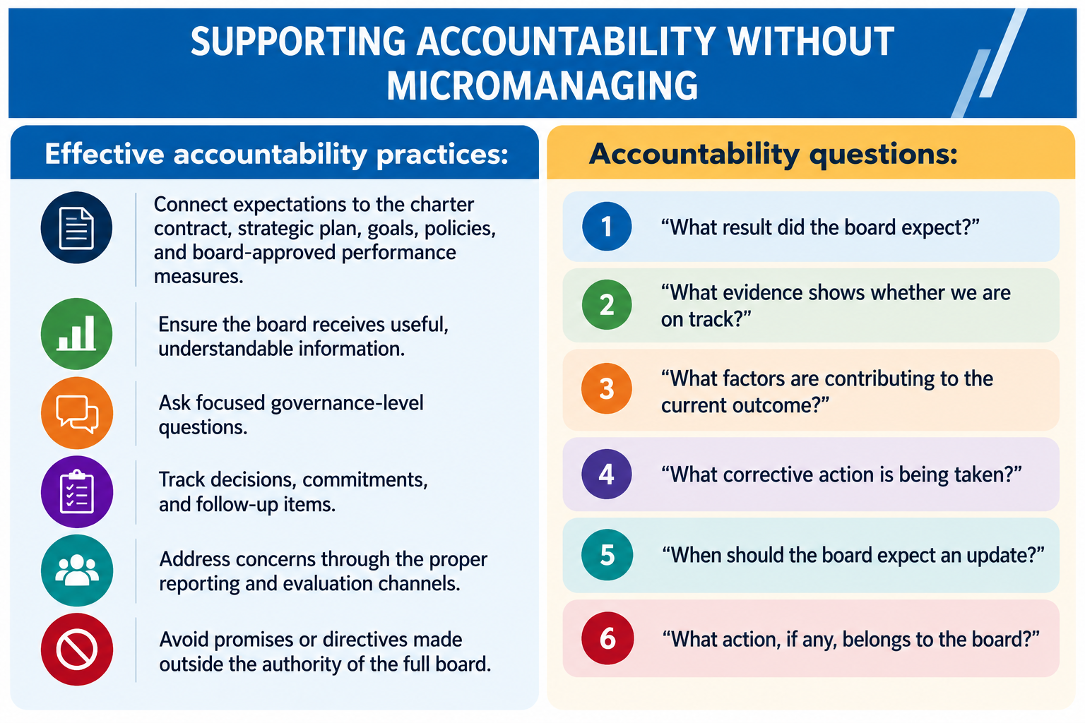
SUPPORTING ACCOUNTABILITY WITHOUT MICROMANAGING
Notes:
This is probably one of the most challenging areas for boards: How do we hold people accountable without managing their work?
The difference often comes down to the kinds of questions the board asks.
Micromanagement tends to focus on how staff members are doing their jobs.
Governance-level accountability focuses on expectations, evidence, results, and follow-through.
Look at the sequence on the right.
What result did the board expect?
What evidence shows whether we’re on track?
What factors are contributing to the current outcome?
What corrective action is being taken?
When should the board expect an update?
And then the critical final question: What action, if any, belongs to the board?
Sometimes the answer is: none.
The board may simply need to monitor the situation and receive another report.
Accountability does not require the board to take over the work. It requires the board to establish expectations and then responsibly monitor results.

Slide 9
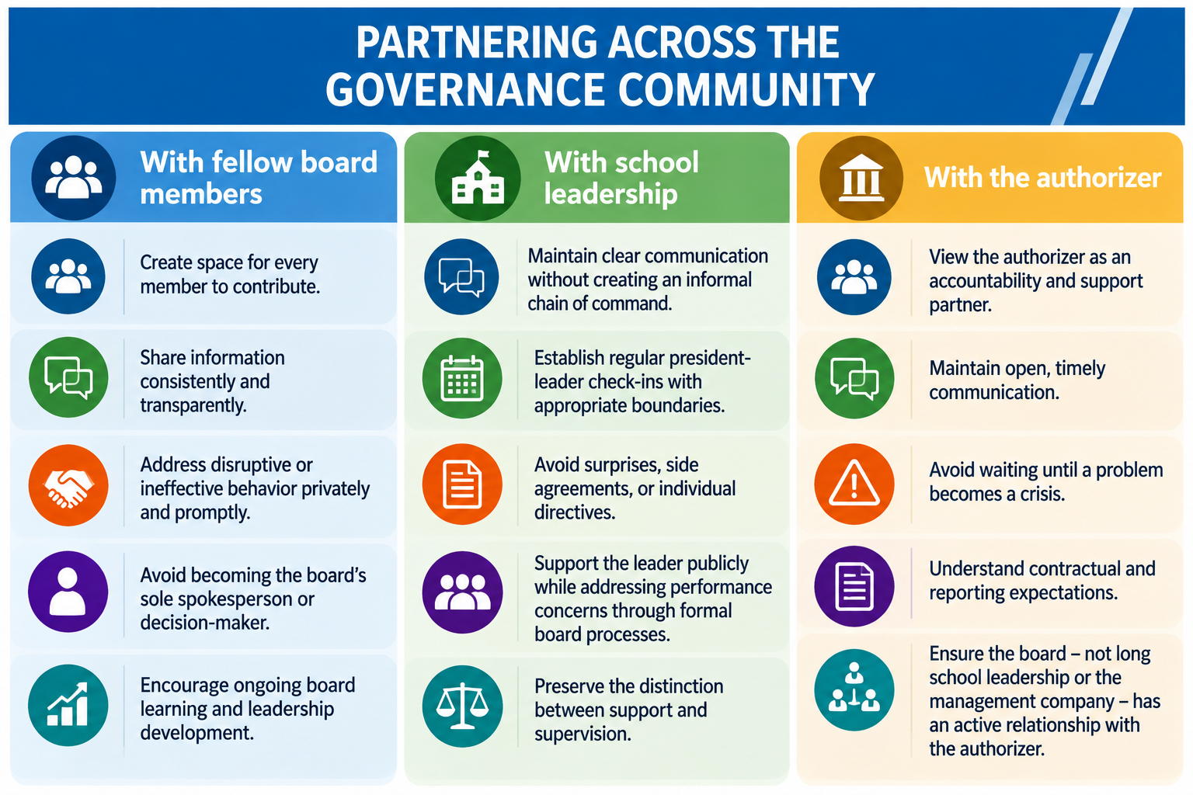
PARTNERING ACROSS THE GOVERNANCE COMMUNITY
Notes:
Officer leadership also extends beyond the board meeting.
Presidents and vice presidents sit at an important intersection within the governance community.
With fellow board members, effective officers create space for participation, share information consistently, address problematic behavior appropriately, and encourage ongoing board development.
With school leadership, they maintain regular communication – but without creating an informal chain of command.
That’s important. A president can have a strong relationship with the school leader without becoming the school leader’s supervisor outside of the board’s established processes.
And then there is the authorizer relationship.
I encourage boards to think of the authorizer as both an accountability and support partner.
That means communicating proactively – not waiting until something has become a crisis.
And notice the final point: the relationship with the authorizer should belong to the board, no exclusively to school leadership or the management company.
Health governance relationships are intentional, transparent, and appropriately bounded.
Partnership principle: Strong relationships do not eliminate accountability; they make honest accountability possible

Slide 10
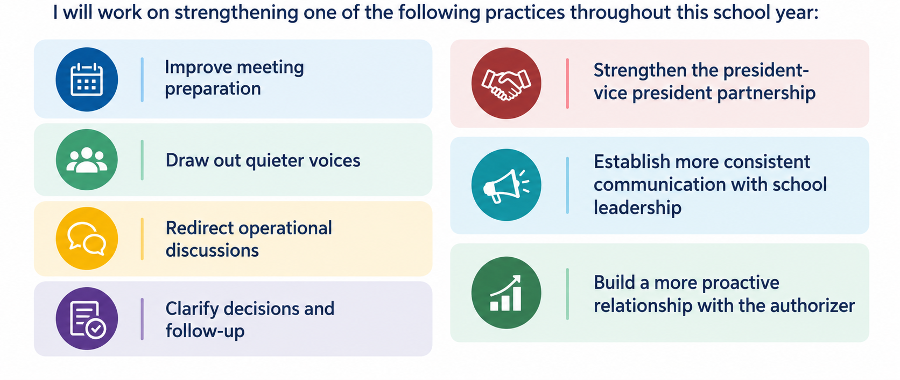
THE OFFICER LEADERSHIP COMMITMENT
Notes:
I want to close the content portion of our session by asking you to make this practical.
There are six leadership practices on this slide.
Rather than trying to improve everything at once, I’d like you to identify one.
Maybe it’s improving meeting preparation.
Maybe you need to draw out quieter voices.
Maybe your board has a tendency to drift into operations.
Perhaps decisions and follow-up need to be clearer.
Or maybe the opportunity is relational – strengthening the president/vice president partnership, improving communication with school leadership or becoming more proactive with your authorizer.
Choose the ONE that would make the greatest difference for your board right now.
And then ask yourself: What is the one thing I can do differently at our very next board meeting?
That’s where leadership development becomes real – not in understanding concept, but in changing practice.
Effective board leadership is no measured by how much the president or vice president speaks or controls. It is measured by how well the entire board governs, deliberates, follows through, and works together in service of the school’s mission.

Slide 11
THANK YOU!
4521 Henry Drive
Beaverton, MI 48612
989.239.7555
ANGELA@AIRWINLLC.COM
Presented by:
Angela L. Irwin, Owner
AirWin Educational Services, LLC
Notes:
As we wrap up, I want to leave you with the idea we started with.
Effective officer leadership isn’t about having more authority. It’s about helping the board use its collective authority well.
The strongest presidents and vice presidents create the conditions for other people to succeed. They keep the board focused, invite participation, reinforce appropriate boundaries, support accountability, build relationships, and help the board follow through on its commitments.
When presidents and vie presidents approach their roles that way, they don’t simply lead meetings. THEY BUILD STRONG BOARDS!

